Slide 1

Amazon Sales Analysis
By Kaustubha Ram P
UNID:UMIP16580

Slide 2
Introduction
Sales management has gained importance to meet increasing competition and the need for improved methods of distribution to reduce cost and to increase profits.
Sales management today is the most important function in a commercial and business enterprise.

Slide 3
Main KPIs
Country wise revenue generation
Region wise revenue generation
Country wise profits
Region wise profits
Country wise units sold
Region wise units sold

Slide 4
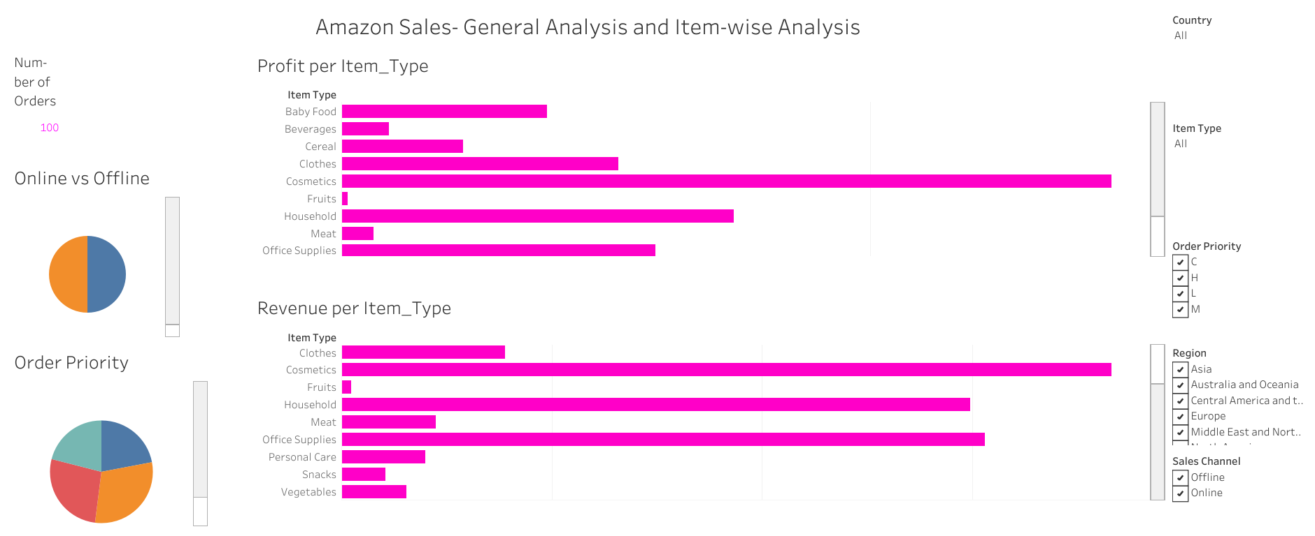
Dashboard 1- General Analysis

Slide 5
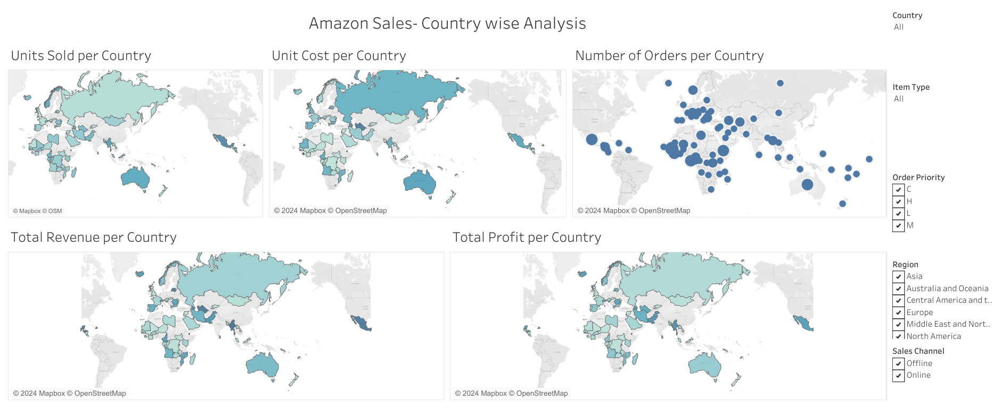
Dashboard 2- Country wise Analysis

Slide 6
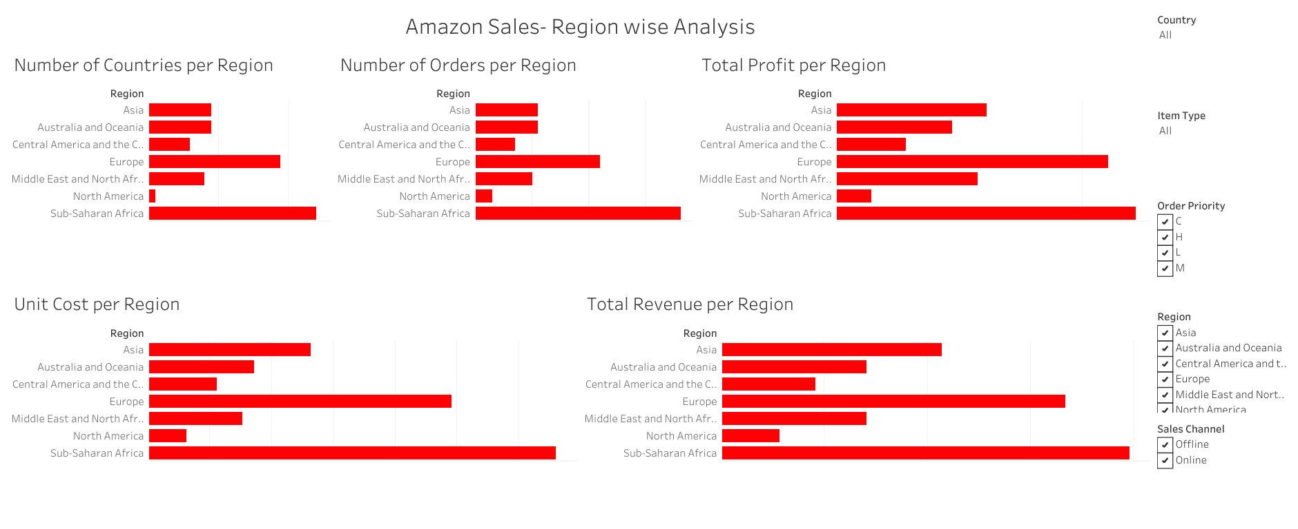
Dashboard 3- Region Wise Analysis

Slide 7
Key Insights- General Analysis
Cosmetics is the lead revenue generator and profit maker
Household generates high revenue but profit is lesser probably due to production/external costs
‘High priority’ is the priority type with most orders
Equal number of online and offline sales channel

Slide 8
Key Insights- Country-wise Analysis
Djibouti is the country with highest profits.
Honduras is the city with highest revenue generation but generates lesser profits
One of the contributing factors to the low profit of Honduras is the high unit cost of 600
Mexico, Djibouti and Australia have the highest number of orders per country
Sao Tome Principe, Djibouti and Mexico have the highest number of units sold.

Slide 9
Key Insights- Region-wise Analysis
Sub-Sahara and Europe generate the highest revenue, highest profits the highest number of orders and the highest unit cost
North America has the least revenue, least profits the least number of orders and the least unit cost

Slide 10
THANK YOU

